Slide 1
Bootstrap Components
Components Based on CSS -Day 2

Slide 2
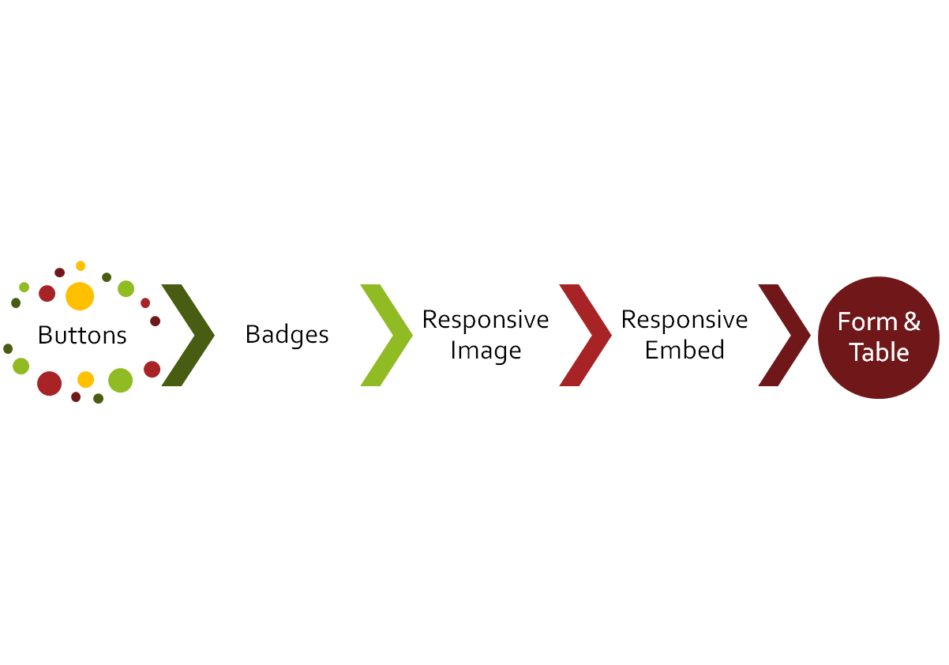
CLASS
OUTLINE

Slide 3
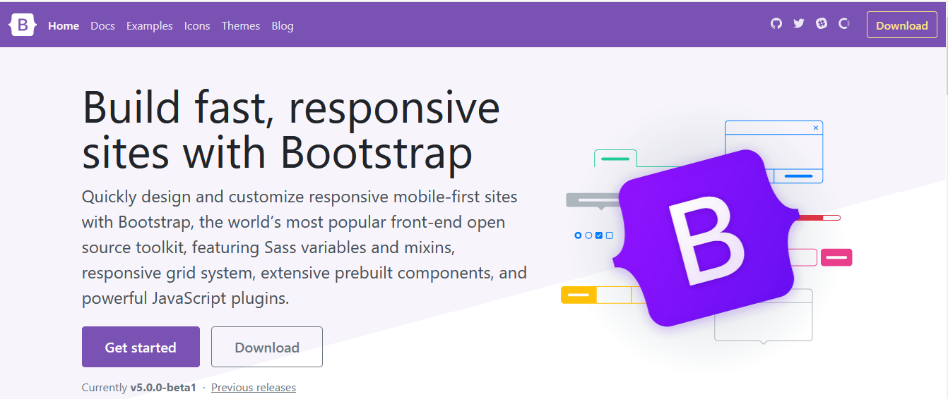
Introduction to the Official Documentation : http://getbootstrap.com

Slide 4
The Display Property
These are a group of responsive display utilities which can be mixed.
The general syntax is as follows:
.d-{value} for xs
.d-{breakpoint}-{value} for sm, md, lg, xl, and xxl.
Where value can be one of: none, inline, block, inline-block, flex
Examples: d-none will be set to display:none on all devices (smallest devices and above), d-sm-none will be set to display:none on small devices and above.
An application of this is to hide certain elements such as video on small devices and make it show on large screens

Slide 5

How do you hide the banner image on small devices?
See notes for answer
Notes:
Class d-none hides the image on small devices and above (all devices) , add d-md-block to make it show on other devices

Slide 6
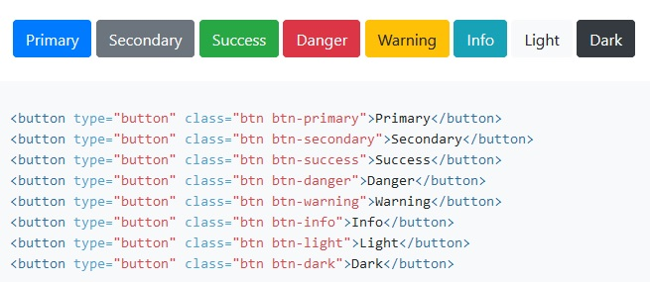
Button
You can style your button tag with the combination of class below:
The class btn which creates the necessary padding and the btn-contextual classes which can be applied to affect the colors.
It doesn’t have to be a button tag, it can be an input of type button too, it can even be an anchor tag!
Notes:
.sr-only can be used to display the visual effects created by the bootstrap classes to screen reader

Slide 7
Button
.btn-outline-contextual can be used to create a button with an outline
eg <button class=‘btn btn-outline-primary’>Register</button>
Add .btn-lg or .btn-sm to change the size
Make buttons look inactive by adding the disabled boolean attribute to any <button> element.
You can use the display block class to make a button a block level element
You can make use of the grid classes to make the button fill up the containing div eg <button class=“col-6”>Submit</button> will occupy half of the containing div

Slide 8
Badges and Typography
Bootstrap Components

Slide 9

Badges (found under Components)
A span can be created with the .badge class to provide labeling components, it can be used within a link or button to provide a counter for example.
It can be combined with the contextual classes to offer colors. (bg) eg bg-primary
The .rounded-pill can be further applied to badge to make it more rounded

Slide 10
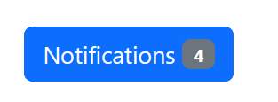
Badges (found under Components)
Since it works as an inline element, it can further be used in other elements like the button tag to provide more highlights

Slide 11
Typography, Spacing and Contextual colors
BS5 includes some responsive-friendly margin and padding
Spacing utilities that apply to all breakpoints, from xs to xl, have no breakpoint abbreviation in them
The classes are named using the format
  {property}{sides}-{size} for xs
  {property}{sides}-{breakpoint}-{size} for sm, md, lg, and xl.
  For example: mt-4 , mt-lg-4
  Properties are m (margin), p( padding)
  Sides: t (top) b (bottom), s (start), e (end), x (both *-left and *-right) , y (both *-top and *-bottom), blank(all 4 sides of the element)
  Size : 0 -5, auto - for classes that set the margin to auto
.mx-auto class can be used for horizontally centering fixed-width block level content—that is, content that has display: block and a width set
  <div class=‘mx-auto’>contents</div>

Slide 12
Responsive Image & Embed
Rather than set the image width and height, use the bootstrap image responsive classes

Slide 13

Responsive Image
Images can be made responsive in Bootstrap with the .img-fluid class, the image then scales with the parent element. Note that the image scales up with the parent (col div)
QUIZ: HOW DO YOU ACHIEVE THIS?
Notes:
Possible solutions:
SOLUTION ONE:
Two rows : ‘Featured Projects’ resides in the first row. The 3 images reside in the 2nd row
SOLUTION TWO:
One row with 4 columns div, the first column is col-12 and contains ‘Featured Projects’ , while others fall under it
an image placed in col-6 will be bigger than that placed in col-2

Slide 14
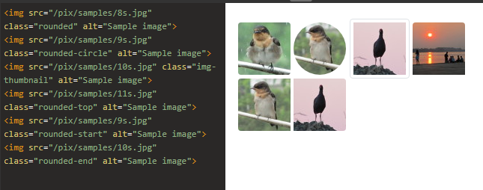
Responsive Image
In addition to img-fluid, you can add any of the following classes to further affect the look and feel of the image
Use .img-thumbnail to give an image a rounded 1px border appearance.
Use .rounded to make your image have rounded edge(s) as follows:

Slide 15
Responsive Embed
As much as possible, to achieve responsiveness, we avoid setting width (and height) for our elements
To make any embed element responsive, do not set width and height for the <iframe>,
In a parent element, add class .ratio and an aspect ratio class (eg ratio-16x9)
Other available ratio are; 1x1, 4x3, 16x9,21x9
The immediate child element is automatically sized
Note that the embedded object scales up with the parent, an object embedded in col-6 will be bigger than that in col-2
<div class="ratio ratio-16x9">
  <iframe src=“https://www.youtube.com/embed/zpOULjyy-n8?rel=0”></iframe>
</div>

Slide 16
Styling Your Form Elements with BS
BOOTSTRAP FORM : https://getbootstrap.com

Slide 17
Login Form
Lets create a simple login form with username, password fields respectively and a login button.

Slide 18
Bootstrap Forms (found under components)
Every label/input pair should be placed within a div to group them
<div>
<label for=“txtemail" class="form-label">Email address</label>
<input type="email" class="form-control" id="txtemail">
</div>
The containing div may be given the margin class to create space before the next div eg mb-3
Give all textual <input> and <textarea> elements class .form-control to get padding and 100% width
Add class .form-select to select menus
In addition to form-control, add form-control-lg or .form-control-sm and that of select menu with form-select-lg, form-select-sm to change the size of the form input elements
Add .form-label class to each label element

Slide 19
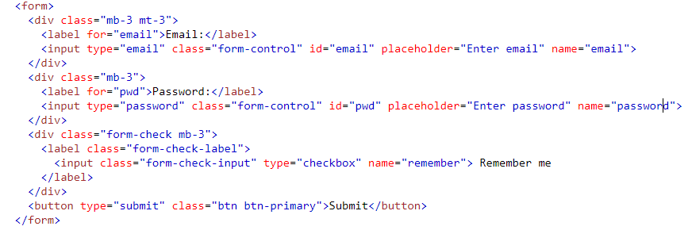
Bootstrap Forms

Slide 20
Checkboxes and radio buttons
checkboxes and radio buttons and their respective labels should be grouped together by placing them in a div with the class form-check
The label should have class form-check-label
and the checkbox/radio button should have form-check-input
<div class="form-check">
<input class="form-check-input" type="checkbox">
<label class="form-check-label">Option 1</label>
</div>

Slide 21
Bootstrap Form Layout
Your form can have any of 3 layouts below:
  Vertical form (this is default)
  Inline form
  Horizontal form
Its good to use label to lay out the form elements to help screen readers. To hide label except screen readers. Add the class= “visually-hidden” to your label

Slide 22
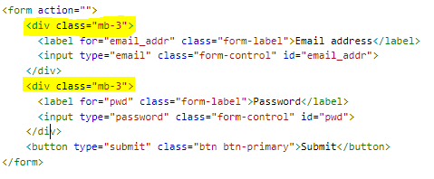
Default Form - Vertical
Each form label and its input field combination must be within a div with the margin bottom or margin top class “mb-3 mt-3”
<div class=“mb-3 mt-3”>
label and input
</div>
All textual input fields should each have class ‘form-control’.
Check the note for source code
Notes:
<div class='row'>
<div class='col'>
<form action="">
<div class="mb-3">
<label for="email_addr" class="form-label">Email address</label>
<input type="email" class="form-control" id="email_addr">
</div>
<div class="mb-3">
<label for="pwd" class="form-label">Password</label>
<input type="password" class="form-control" id="pwd">
</div>
<button type="submit" class="btn btn-primary">Submit</button>
</form> </div>
</div>

Slide 23
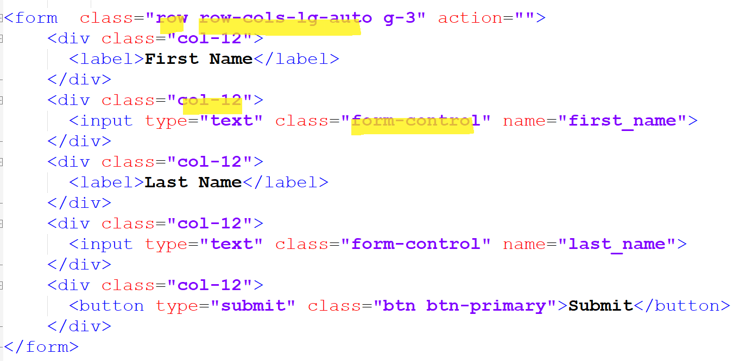
Inline form, class=‘row row-cols-lg-auto’
Place the classes row and row-cols-*-auto within the form tag
Each form label must be within a div with the class col-12
Each form input field must be within a div with the class col-12
The Bootstrap's .row-cols-* classes will create responsive horizontal layouts. Using .col-12 helps stack the form controls on narrow viewports.
Adding gutters help ensure space from one col-12 to another when they stack over (see last slide)
All textual input fields should each have class form-control as usual
Notes:
<form class="row row-cols-lg-auto g-3" action="">
<div class="col-12">
<label for="first_name">First Name</label>
</div>
<div class="col-12">
<input type="text" class="form-control" id="first_name" name="first_name">
</div>
<div class="col-12">
<label for="last_name">Last Name</label>
</div>
<div class="col-12">
<input type="text" class="form-control" id="last_name" name="last_name">
</div>
<div class="col-12">
<button type="submit" class="btn btn-primary">Submit</button>
</div>
</form>

Slide 24
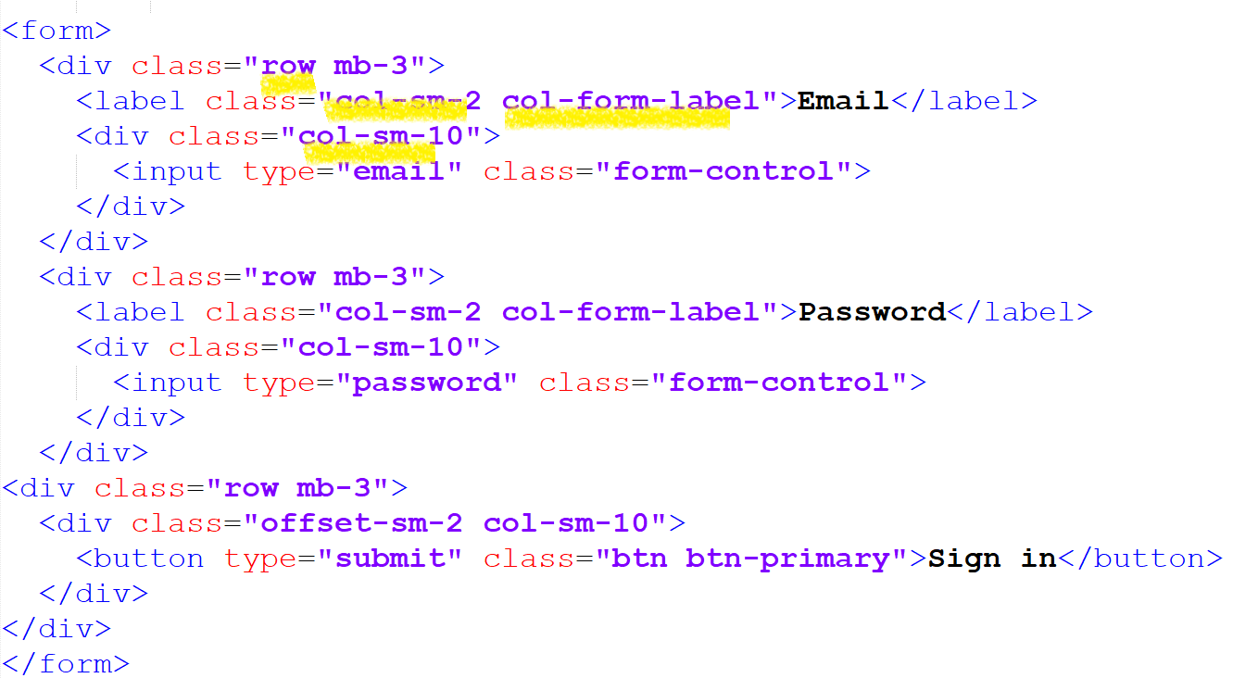
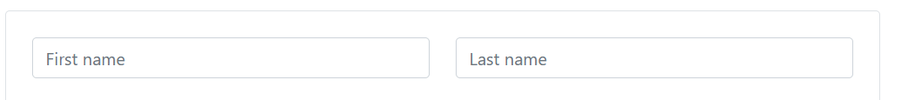
Horizontal form – form that require multiple columns
This type of layout uses the bootstrap grid system to lay out the form especially used when the form has multiple layouts
The label + input elements should be within a single div that has class row.
Use class col-*-* to specify the width of your labels and controls.
Add .col-form-label to your <label> to make the vertically centered with their associated form controls.
All textual input fields should each have class ‘form-control’ as usual
Notes:
<form>
<div class="row mb-3">
<label for="inputEmail3" class="col-sm-2 col-form-label">Email</label>
<div class="col-sm-10">
<input type="email" class="form-control" id="inputEmail3">
</div>
</div>
<div class="row mb-3">
<label for="inputPassword3" class="col-sm-2 col-form-label">Password</label>
<div class="col-sm-10">
<input type="password" class="form-control" id="inputPassword3">
</div>
</div>
<div class="row mb-3">
<div class="offset-sm-2 col-sm-10">
<button type="submit" class="btn btn-primary">Sign in</button>
</div>
</div>
</form>

Slide 25
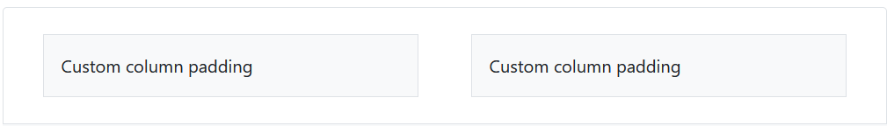
Form Layout: controlling the gap
You can have control over the gutter width (the space between two col(umn) divs by using the gutters utilities)
See syntax: Apply the class on the row div
  g-1 represents 1 gutter starts from 1.5em
  gy-1: represents 1 vertical gutter
  gx-1 represents 1 horizontal gutter

Slide 26
Responsive Table
Avoid setting fixed width in px!

Slide 27
Bootstrap Table (found under contents)
Your table should contain thead, tbody to sectionalize the various table sections
Add class table to the table tag to add the necessary padding to an usual html table to make it responsive
You can further extend the look of the table with more classes:
<table class="table">
<thead>
<tr>
<th scope="col">#</th>
<th scope="col">First</th>
</tr>
</thead>
<tbody>
---
</tbody>
</table>

Slide 28
Bootstrap Table (found under contents)
In addition to the table class, use .table-dark, .table-striped to add zebra-striping, .table-bordered for borders on all sides of the table and cells, .table-hover to enable a hover state on table rows
thead can be formated using .thead-light or .thead-dark to make <thead>s appear light or dark gray.
Non-conflicting classes can be combined.

Slide 29
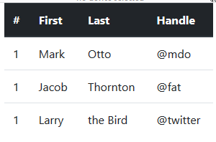
Bootstrap Table (found under Contents)

Slide 30
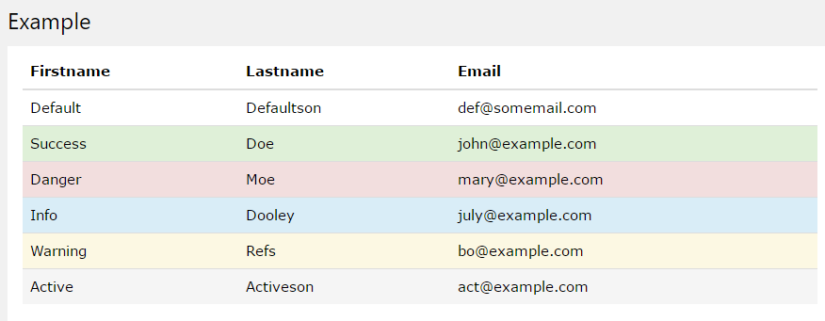
Bootstrap Table (found under Contents)
Contextual classes can be used to color table rows (<tr>) or table cells (<td>):
<tr class=‘table-primary’><td>content</td></tr>

Slide 31
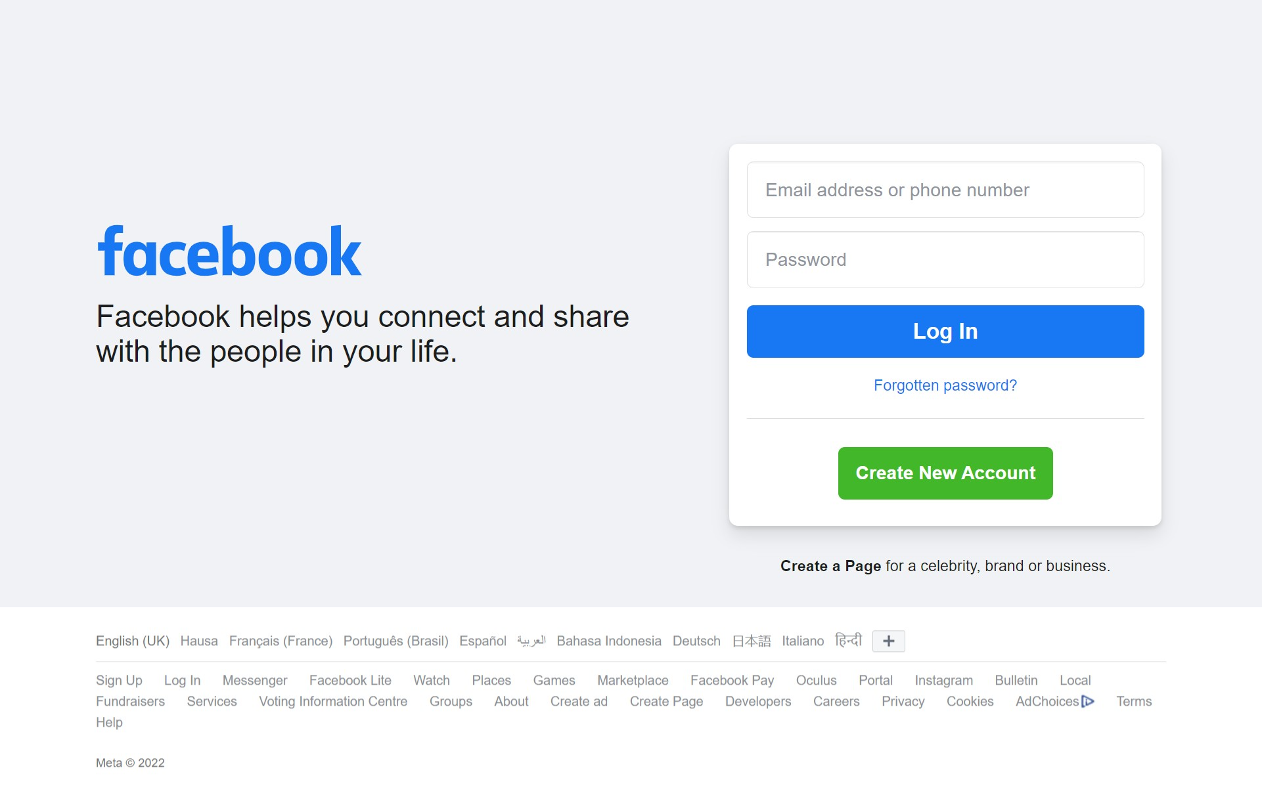

ASSIGNMENT
Achieve this responsively – The new Face book Home page
On a large screen
On a mobile phone

Slide 32
Personal Practice
The Next slide is just for your personal practice.
If you have some time, help make the old facebook page responsive

Slide 33
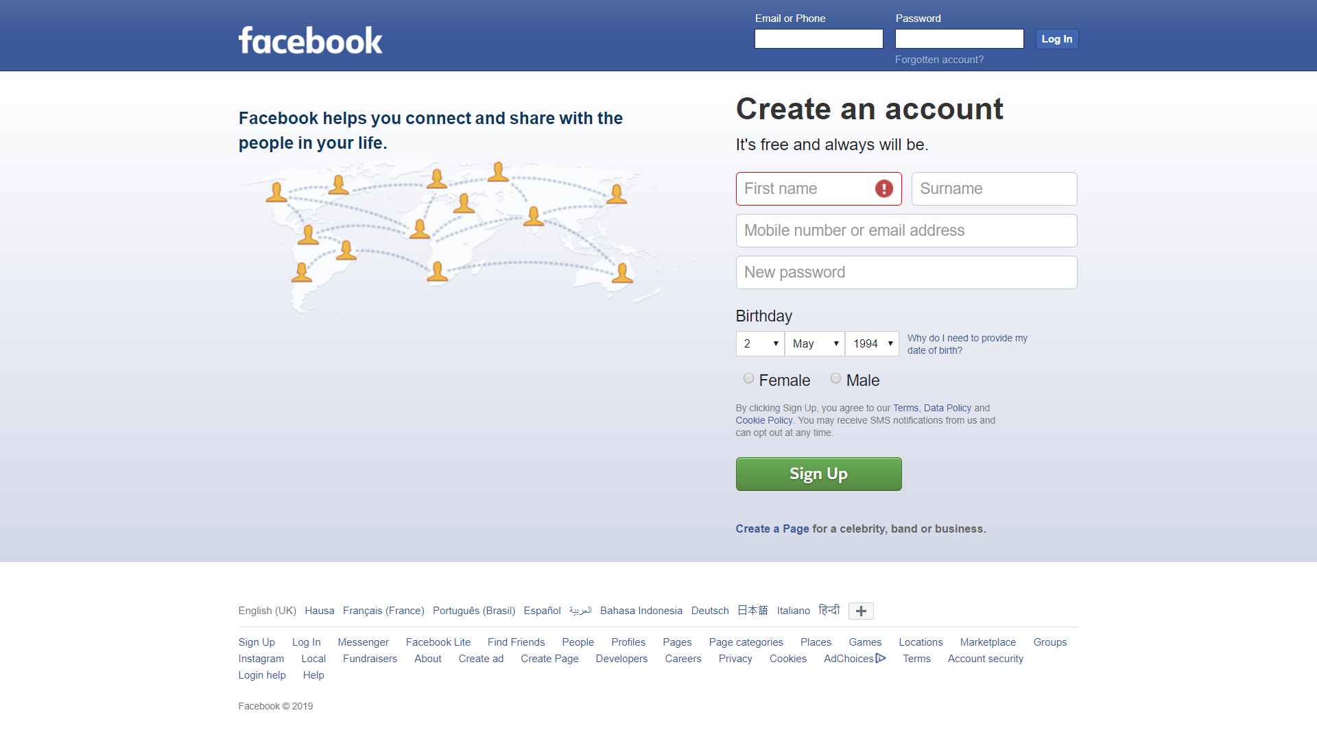
Go Further!
Help make the old facebook responsive

